Slide 1
Network Security
CS 6823 - Lecture 0
Introduction, Expectations, and Policies
Phillip Mak
pmak@nyu.edu

Slide 2
Who am I?
Phillip Mak
MS CS (concentration in Information Security) at NYU Poly
Cyber
Cyber Security Principal / Security Operations Center Lead
Formally 12 years career as Cybersecurity Lead at the Department of Defense
Network Communications Intern at N.Y.S.E
Provide systems and security engineering services to Army programs during the development lifecycle
Cybersecurity monitoring during live operational testing of networked system
Cybersecurity protections for DoD systems
<number>

Slide 3
Course Organization
<number>

Slide 4
WARNING You will be learning potentially dangerous techniques in this course. By continuing the beyond this point you agree that all of the knowledge gained will be used in an ethical manner. The point of this course is to learn about network security not to harm people or systems. If you do, you will end up in jail and I won’t be able to (or will) save you.
<number>

Slide 5
Contact Information
The best way to reach me us by email:
pmak@nyu.edu
Office hours: By appointment on Skype: phillip.mak
Feel free to make an appointment for general discussions. You don’t need to have a problem to chat.
Slack
You can also send me a message anytime on Slack, but that’s more informal.
Please do email me any suggestions, questions, topics, or interesting tidbits or articles you may have, which I will try go over them at the next class. This allows me to talk about topics that you have an interest with.
<number>

Slide 6
Course Website
Main Website: https://newclasses.nyu.edu/
VLAB: https://vital.engineering.nyu.edu/vital/
Syllabus - subject to change so check the NYU Classes “Syllabus”
Lecture Slides - will be posted prior to class. Students must review the slides before the corresponding lecture
Assigned Readings are typically news and research articles related to current events in Cybersecurity
<number>

Slide 7
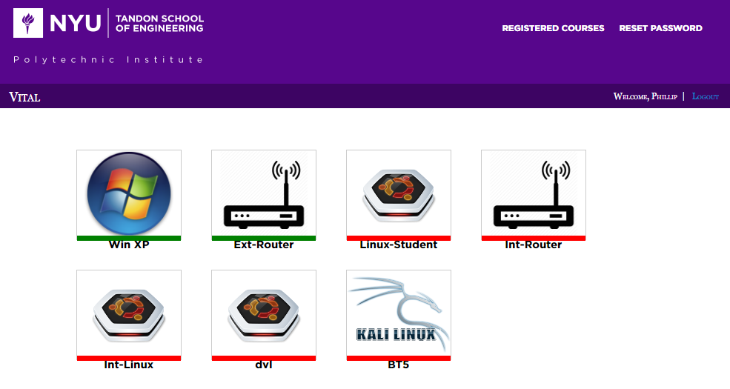
Virtual Lab (VLAB)
Allows usage and practice of security tools in a controlled environment. Lab 0 details how to get setup
https://vital.engineering.nyu.edu/vital/
Registration Code: s5EHR83R
<number>

Slide 8
VLAB Architecture
<number>

Slide 9
Course Goals
Understand the problems of securing a network
Understand the underlying protocols and technologies
Crypto, IPsec, TLS
Examine the methods and tools for attacking and defending a network
network reconnaissance, enumeration, exploits, tools.
defense tools (firewalls, ids, router, switches, wireless)
Explore some advanced topics
E.g., Wireless, IPv6
<number>
Notes:
Purpose: Security concepts, not specific technologies
Next several classes: All the steps that a hacker needs to break into a system:
Gathering information – what IP addresses are owned, topology
Identifying hosts and services
Finding vulnerabilities
Exploitation: gaining access, elevating access
Post-Exploitation: maintaining access, removing traces
Cryptography: how encryption works, how SSL works
Network Defense Tools
IPv6
<number>

Slide 10
Textbook
No textbook assigned.
Rather than a textbook, reading materials (such as URLs, papers, news articles) will be regularly assigned and posted on NYU Classes.
Material from these sources are fair game for exams even if the material is not covered in class
<number>
Notes:
Stack Exchange
<number>

Slide 11
Prerequisites
Good Foundation in Networking and TCP/IP. CS 684 or equivalent course in computer networking.
Reference: Internetworking with TCP/IP, Vol 1, 5th Edition, Doug Comer
Basic understanding of operating systems with a working knowledge of Linux.
<number>
Notes:
TCP/IP: understanding the OSI model
ARP vs. IP
Ethernet, IP, TCP packet
Linux – Lab 1
Course difficulty – Computer Security
- make clear what the prerequisits
- don't have it, they should drop the class
- NYU only has one week to add/drop. next monday
- 3.4 is the average grade
<number>

Slide 12
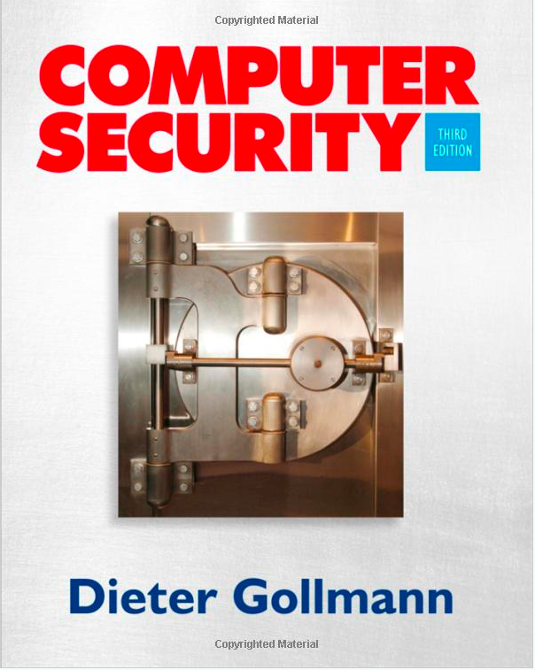
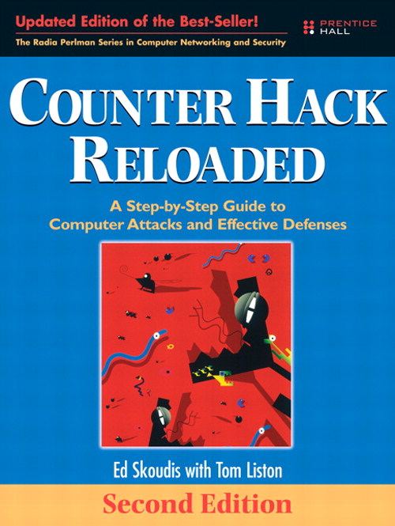
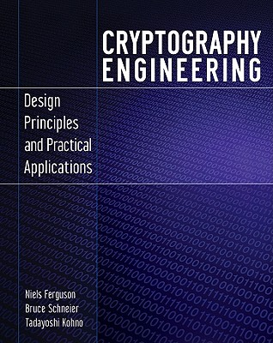
Optional Textbooks (none required)
Computer Security Second Edition (Optional)
Dieter Gollmann
ISBN: 0470741155
Published: 2011
Counter Hack Reloaded (Optional)
Ed Skoudis
ISBN: 0131481045
Published: 2006
Cryptography Engineering (Optional)
Neils Ferguson, Bruce Schneier
ISBN: 978-0-470-47424-2
Published: 2010
<number>
Notes:
Books not required, but it helps a lot to get you into the mindset of fundamentals
<number>

Slide 13
Course Policies
10% Homework & Quizzes
30% Labs
30% Midterm
30% Final
Bonus points given for optional weekly exercises, approximately equal to 1 HW assignment (~2%)
Syllabus on NYU Classes
No late assignments accepted. No Dropped Labs
Plagiarism policy – Don’t do it
https://engineering.nyu.edu/academics/code-of-conduct/academic-dishonesty
Notes:
How to get an A
change of grades are not allowed
Plagiarism in academics vs. legal
No tolerance
<number>

Slide 14
Weekly Exercises
During lecture each week, there are optional exercises during the lecture
Submit responses in the “Week X Exercises” assignments
Bonus points given for submission (equal to 1 HW for all)
<number>

Slide 15
Course Expectations
Expected workload is approximately 13 hours a week
Student should be prepared for each lecture
Review Lecture Slides
View reading materials
View lecture, either live or recording
Labs and Homeworks
Ample time will be given to complete each assignment
Online class:
Weekly Webinars will be used to review the materials and go over confusing or difficult portions.
If you’re not able to attend live, then please ensure you view the recording
Lectures will be recorded and available
<number>

Slide 16
Prepping for Class
Join Slack
Provide a quick intro to include
Info about yourself, e.g., major, expected graduation
Any prior Cyber experience or Cyber classes
Any particular topic you’re interested in
An interesting fact about yourself
Set up calendar feed
https://newclasses.nyu.edu/access/calendar/ical/ns_su2019.ics
(Same calendar as shown in NYU Classes “Calendar”)
Set up VLAB
Register at
https://vital.engineering.nyu.edu/vital/
Registration code s5EHR83R
<number>

Slide 17
Things That I Won’t Do at the End of the Course
Give you extra work so that you can try and improve your grade
Bump your grade up because you feel that you deserve it, need it for a scholarship, etc.
Review earlier assignments in an effort to try and “find’ points.
Unless there is a true grading error, do not come asking for extra points.
<number>

Slide 18
Syllabus
Week | Date | Lesson
1 | Mon, 03 Jun | Lesson 0: Introduction, Expectations, and Policies Lesson 1: Security Basics: Terms & Definitions, Risk Assessment
2 | Mon, 10 Jun | Lesson 2: Recon
3 | Mon, 17 Jun | Lesson 3: Vulnerabilities and Exploits Part I
4 | Mon, 24 Jun | Lesson 3: Vulnerabilities and Exploits Part II
5 | Mon, 01 Jul | Lesson 4: Attacks - Owning the Box, Post-Exploitation
6 | Video Only | Lesson 5: Cryptography - Randomness, Primes, RSA, DH
 | Mon, 08 Jul | NO CLASS - Exam Week
 | Sat, 13 Jul @10AM | Midterm on Lessons 1-5 Only
7 | Mon, 15 Jul | Lesson 6: MI, PKI and TLS Part I
8 | Mon, 22 Jul | Lesson 6: MI, PKI and TLS Part II
9 | Mon, 29 Jul | Lesson 7: Layer 2 Security
10 | Mon, 05 Aug | Lesson 8: Firewalls and Perimeter Security Lesson 9: Wireless Security
11 | Mon, 12 Aug | Final Review
 | Sat, 17 Aug @10AM | Final on Lessons 6 Onward Only
<number>

